Slide 1
3D position estimation from N–view images
R09631044 柯筆翔 R09522525 邱浩安

Slide 2
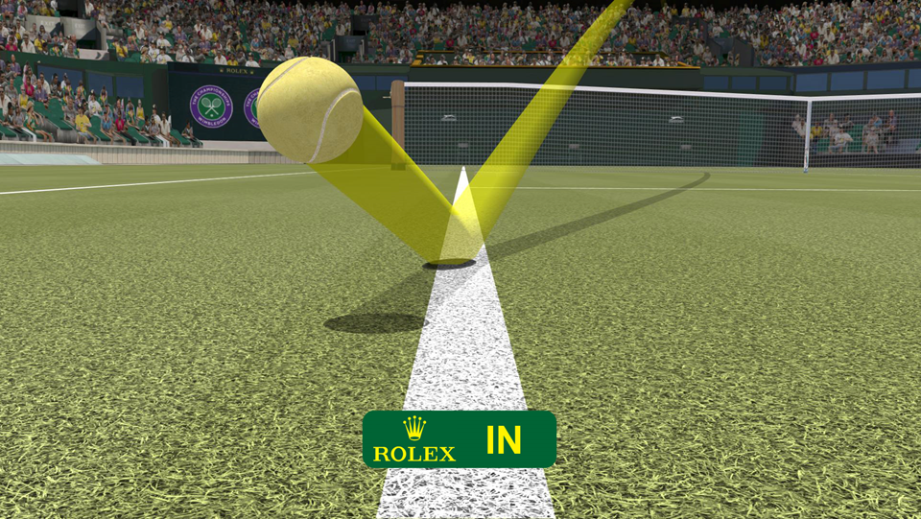
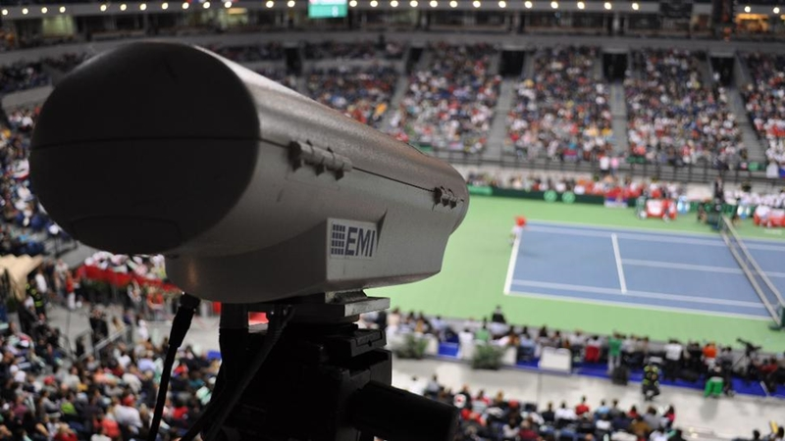
計畫簡介
Notes:
平均誤差為3.6mm，近年則減少至平均2.6mm

Slide 3
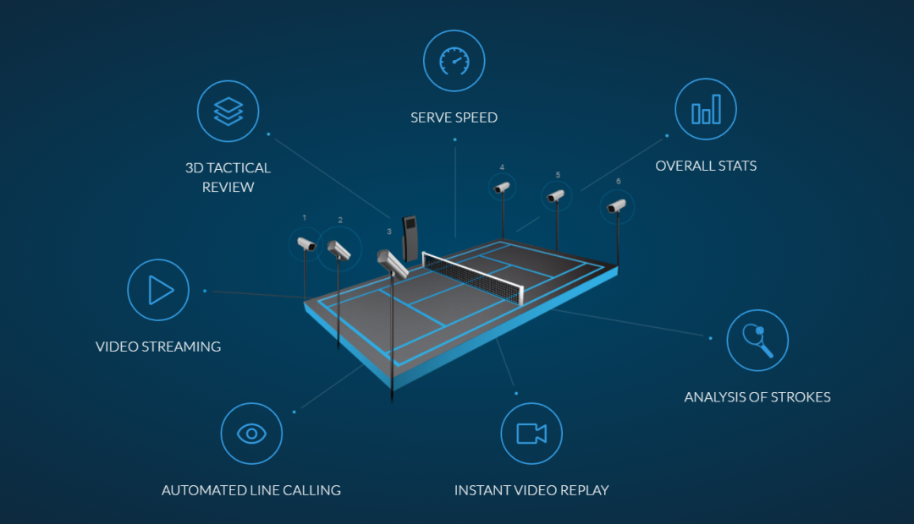
計畫簡介
Notes:
Start from 2 cameras
Then N>=3 (why? 數值穩定性 以及 敏感性與死角)
Off-line
Cameras don’t rotate

Slide 4
Outline
模擬環境的建置並與python連接
準確控制球的路徑與速度，以及兩台相機位置與角度
將球在不同時刻的空間位置記錄下來，並匯出為csv檔案
將模擬環境中兩台相機取得的影像儲存於指定資料夾
Canny edge detection + Hough transform for circle
Canny edge detection + Blob detection
Find yellow ball with Blob detection in color space
數學模型推導與初步驗證

Slide 5
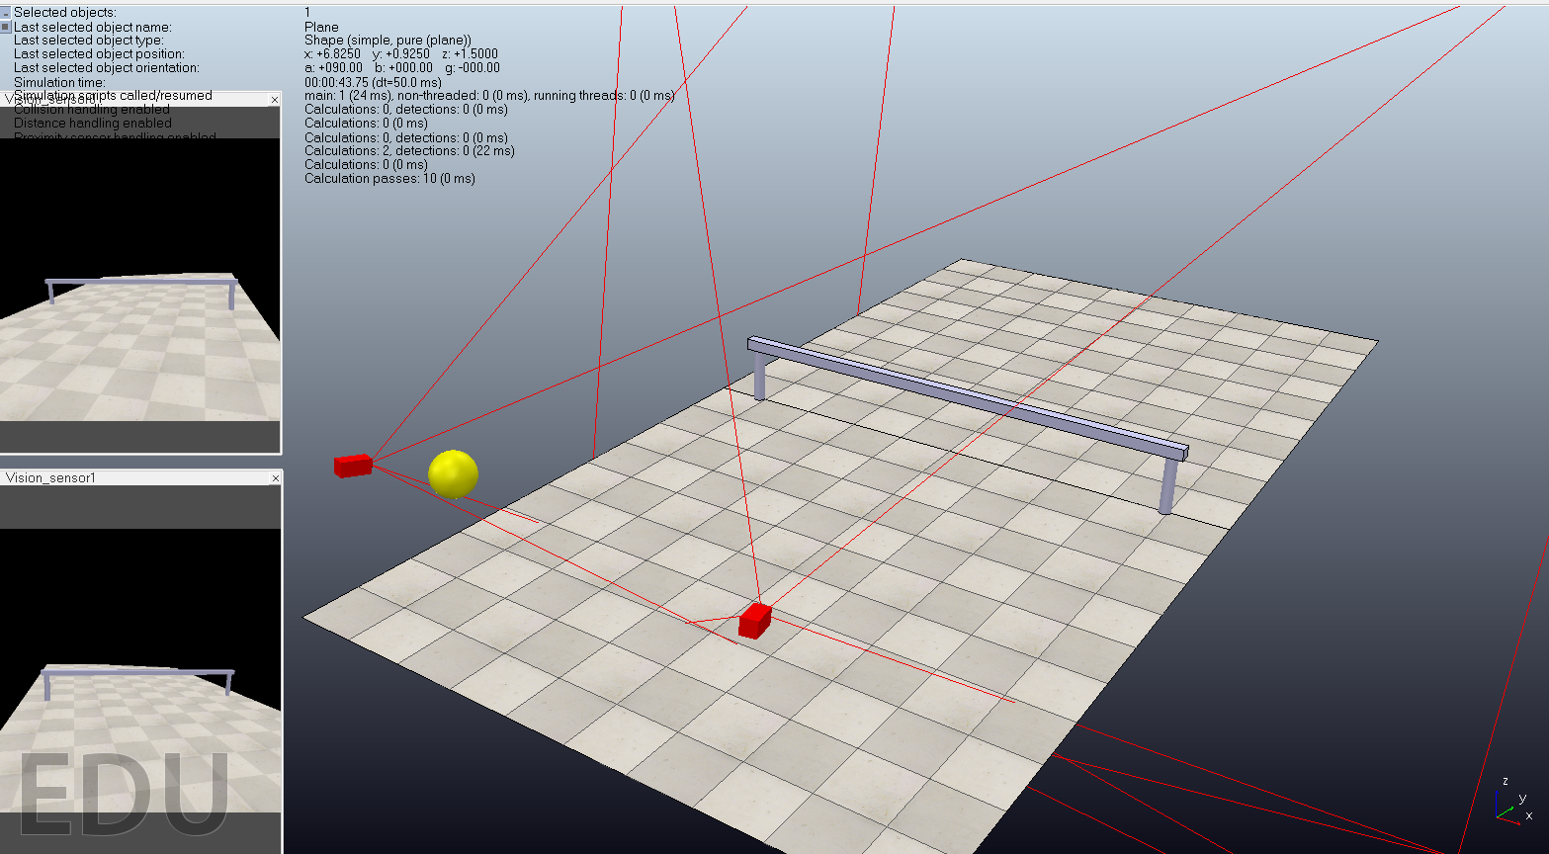
模擬環境的建置並與python連接

Slide 6
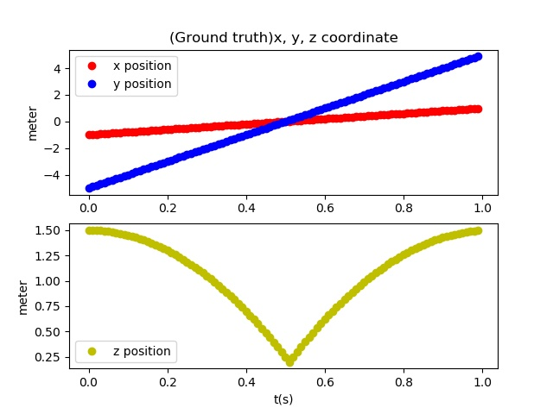
控制球的路徑 & 兩台相機位置與角度

Slide 7
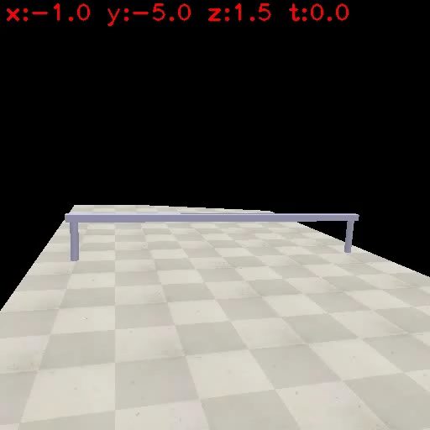
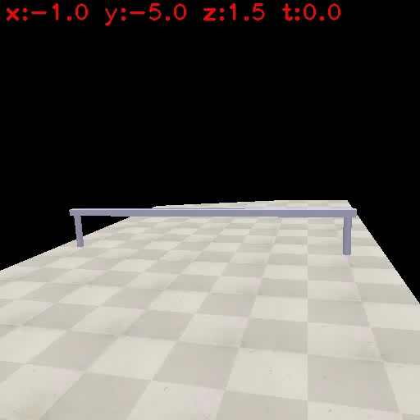
控制球的路徑 & 兩台相機位置與角度

Slide 8
取得球心於影像中的座標
Canny edge detection + Hough transform for circle
Canny edge detection + Blob detection
Find yellow ball with Blob detection in color space

Slide 9
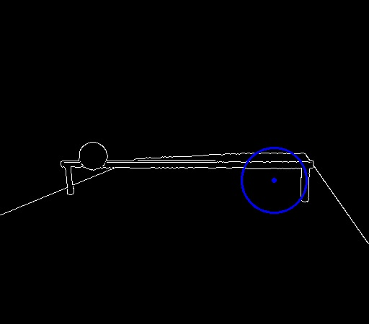
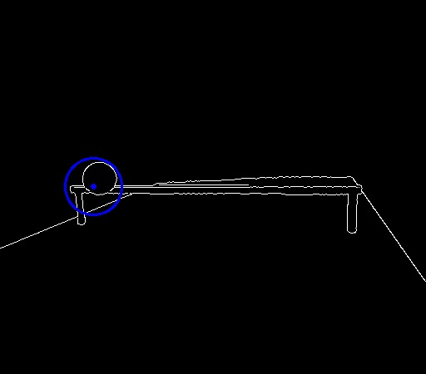
Canny edge detection + Hough transform for circle
Not robust enough!

Slide 10
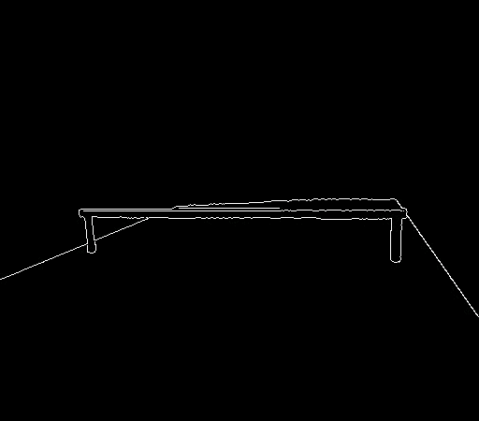
Canny edge detection + Blob detection

Slide 11

Find yellow ball with Blob detection in color space

Slide 12
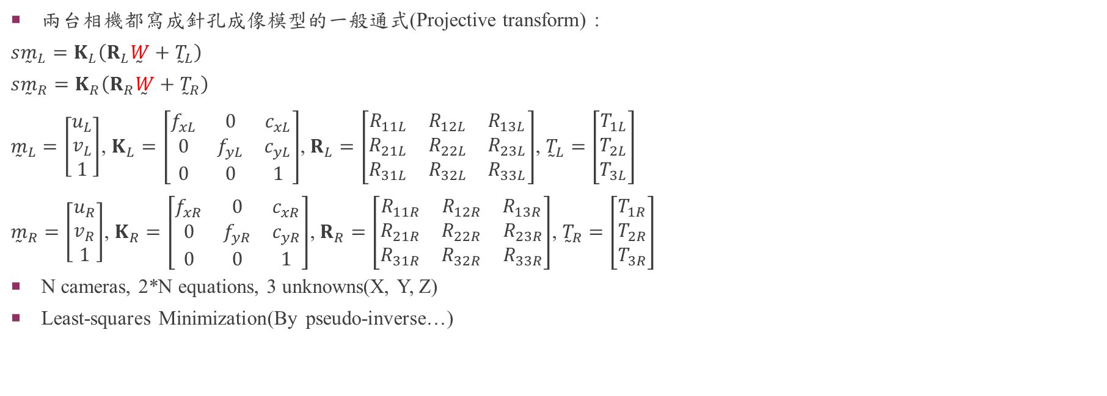
數學模型推導
兩台相機都寫成針孔成像模型的一般通式(Projective transform) :
$$s{\overset{̰}{m}}_{L}=K_{L}\left(R_{L}\overset{̰}{W}+{\overset{̰}{T}}_{L}\right)$$
$$s{\overset{̰}{m}}_{R}=K_{R}\left(R_{R}\overset{̰}{W}+{\overset{̰}{T}}_{R}\right)$$
${\overset{̰}{m}}_{L}=\left[\begin{matrix}u_{L} \\ v_{L} \\ 1\end{matrix}\right]$, $K_{L}=\left[\begin{matrix}f_{xL} & 0 & c_{xL} \\ 0 & f_{yL} & c_{yL} \\ 0 & 0 & 1\end{matrix}\right]$, $R_{L}=\left[\begin{matrix}\begin{matrix}R_{11L} & R_{12L} & R_{13L}\end{matrix} \\ \begin{matrix}R_{21L} & R_{22L} & R_{23L}\end{matrix} \\ \begin{matrix}R_{31L} & R_{32L} & R_{33L}\end{matrix}\end{matrix}\right]$, ${\overset{̰}{T}}_{L}=\left[\begin{matrix}T_{1L} \\ T_{2L} \\ T_{3L}\end{matrix}\right]$
${\overset{̰}{m}}_{R}=\left[\begin{matrix}u_{R} \\ v_{R} \\ 1\end{matrix}\right]$, $K_{R}=\left[\begin{matrix}f_{xR} & 0 & c_{xR} \\ 0 & f_{yR} & c_{yR} \\ 0 & 0 & 1\end{matrix}\right]$, $R_{R}=\left[\begin{matrix}\begin{matrix}R_{11R} & R_{12R} & R_{13R}\end{matrix} \\ \begin{matrix}R_{21R} & R_{22R} & R_{23R}\end{matrix} \\ \begin{matrix}R_{31R} & R_{32R} & R_{33R}\end{matrix}\end{matrix}\right]$, ${\overset{̰}{T}}_{R}=\left[\begin{matrix}T_{1R} \\ T_{2R} \\ T_{3R}\end{matrix}\right]$
N cameras, 2*N equations, 3 unknowns(X, Y, Z)
Least-squares Minimization(By pseudo-inverse…)

Slide 13
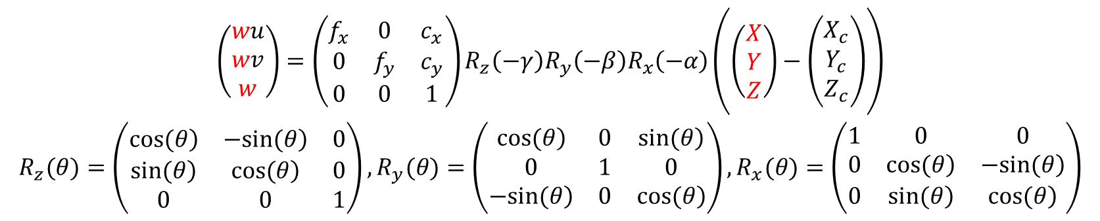
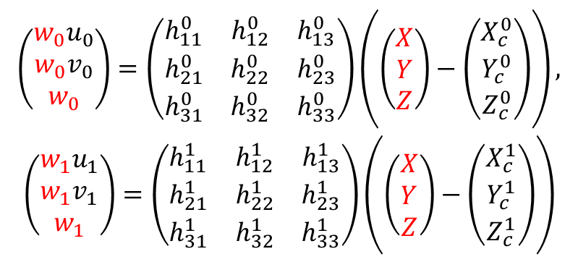
數學模型推導
$$\begin{matrix}\left(\begin{matrix}wu \\ wv \\ w\end{matrix}\right)=\left(\begin{matrix}f_{x} & 0 & c_{x} \\ 0 & f_{y} & c_{y} \\ 0 & 0 & 1\end{matrix}\right)R_{z}\left(−γ\right)R_{y}\left(−β\right)R_{x}\left(−α\right)\left(\left(\begin{matrix}X \\ Y \\ Z\end{matrix}\right)−\left(\begin{matrix}X_{c} \\ Y_{c} \\ Z_{c}\end{matrix}\right)\right) \\ R_{z}(θ)=\left(\begin{matrix}\left.cos(θ\right) & \left.−sin(θ\right) & 0 \\ \left.sin(θ\right) & \left.cos(θ\right) & 0 \\ 0 & 0 & 1\end{matrix}\right),R_{y}(θ)=\left(\begin{matrix}\left.cos(θ\right) & 0 & \left.sin(θ\right) \\ 0 & 1 & 0 \\ \left.−sin(θ\right) & 0 & \left.cos(θ\right)\end{matrix}\right),R_{x}(θ)=\left(\begin{matrix}1 & 0 & 0 \\ 0 & \left.cos(θ\right) & \left.−sin(θ\right) \\ 0 & \left.sin(θ\right) & \left.cos(θ\right)\end{matrix}\right)\end{matrix}$$
$$\begin{matrix}\left(\begin{matrix}w_{0}u_{0} \\ w_{0}v_{0} \\ w_{0}\end{matrix}\right)=\left(\begin{matrix}h_{11}^{0} & h_{12}^{0} & h_{13}^{0} \\ h_{21}^{0} & h_{22}^{0} & h_{23}^{0} \\ h_{31}^{0} & h_{32}^{0} & h_{33}^{0}\end{matrix}\right)\left(\left(\begin{matrix}X \\ Y \\ Z\end{matrix}\right)−\left(\begin{matrix}X_{c}^{0} \\ Y_{c}^{0} \\ Z_{c}^{0}\end{matrix}\right)\right), \\ \left(\begin{matrix}w_{1}u_{1} \\ w_{1}v_{1} \\ w_{1}\end{matrix}\right)=\left(\begin{matrix}h_{11}^{1} & h_{12}^{1} & h_{13}^{1} \\ h_{21}^{1} & h_{22}^{1} & h_{23}^{1} \\ h_{31}^{1} & h_{32}^{1} & h_{33}^{1}\end{matrix}\right)\left(\left(\begin{matrix}X \\ Y \\ Z\end{matrix}\right)−\left(\begin{matrix}X_{c}^{1} \\ Y_{c}^{1} \\ Z_{c}^{1}\end{matrix}\right)\right)\end{matrix}$$

Slide 14
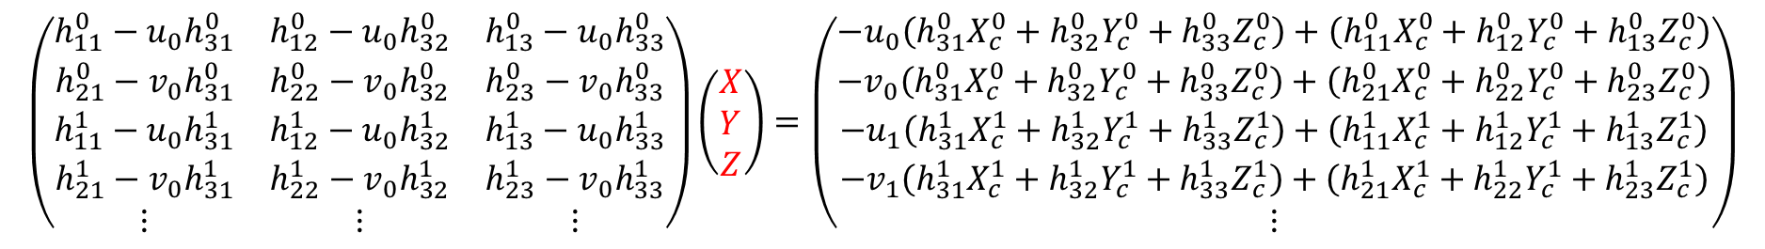

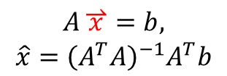
數學模型推導
$$\begin{matrix}\left(\begin{matrix}w_{0}u_{0} \\ w_{0}v_{0} \\ w_{0}\end{matrix}\right)=\left(\begin{matrix}h_{11}^{0} & h_{12}^{0} & h_{13}^{0} \\ h_{21}^{0} & h_{22}^{0} & h_{23}^{0} \\ h_{31}^{0} & h_{32}^{0} & h_{33}^{0}\end{matrix}\right)\left(\left(\begin{matrix}X \\ Y \\ Z\end{matrix}\right)−\left(\begin{matrix}X_{c}^{0} \\ Y_{c}^{0} \\ Z_{c}^{0}\end{matrix}\right)\right), \\ \left(\begin{matrix}w_{1}u_{1} \\ w_{1}v_{1} \\ w_{1}\end{matrix}\right)=\left(\begin{matrix}h_{11}^{1} & h_{12}^{1} & h_{13}^{1} \\ h_{21}^{1} & h_{22}^{1} & h_{23}^{1} \\ h_{31}^{1} & h_{32}^{1} & h_{33}^{1}\end{matrix}\right)\left(\left(\begin{matrix}X \\ Y \\ Z\end{matrix}\right)−\left(\begin{matrix}X_{c}^{1} \\ Y_{c}^{1} \\ Z_{c}^{1}\end{matrix}\right)\right)\end{matrix}$$
$$\begin{matrix}\left(\begin{matrix}h_{11}^{0}−u_{0}h_{31}^{0} & h_{12}^{0}−u_{0}h_{32}^{0} & h_{13}^{0}−u_{0}h_{33}^{0} \\ h_{21}^{0}−v_{0}h_{31}^{0} & h_{22}^{0}−v_{0}h_{32}^{0} & h_{23}^{0}−v_{0}h_{33}^{0} \\ h_{11}^{1}−u_{0}h_{31}^{1} & h_{12}^{1}−u_{0}h_{32}^{1} & h_{13}^{1}−u_{0}h_{33}^{1} \\ h_{21}^{1}−v_{0}h_{31}^{1} & h_{22}^{1}−v_{0}h_{32}^{1} & h_{23}^{1}−v_{0}h_{33}^{1} \\ ⋮ & ⋮ & ⋮\end{matrix}\right)\left(\begin{matrix}X \\ Y \\ Z\end{matrix}\right)=\left(\begin{matrix}−u_{0}\left(h_{31}^{0}X_{c}^{0}+h_{32}^{0}Y_{c}^{0}+h_{33}^{0}Z_{c}^{0}\right)+\left(h_{11}^{0}X_{c}^{0}+h_{12}^{0}Y_{c}^{0}+h_{13}^{0}Z_{c}^{0}\right) \\ −v_{0}\left(h_{31}^{0}X_{c}^{0}+h_{32}^{0}Y_{c}^{0}+h_{33}^{0}Z_{c}^{0}\right)+\left(h_{21}^{0}X_{c}^{0}+h_{22}^{0}Y_{c}^{0}+h_{23}^{0}Z_{c}^{0}\right) \\ \begin{matrix}−u_{1}\left(h_{31}^{1}X_{c}^{1}+h_{32}^{1}Y_{c}^{1}+h_{33}^{1}Z_{c}^{1}\right)+\left(h_{11}^{1}X_{c}^{1}+h_{12}^{1}Y_{c}^{1}+h_{13}^{1}Z_{c}^{1}\right) \\ −v_{1}\left(h_{31}^{1}X_{c}^{1}+h_{32}^{1}Y_{c}^{1}+h_{33}^{1}Z_{c}^{1}\right)+\left(h_{21}^{1}X_{c}^{1}+h_{22}^{1}Y_{c}^{1}+h_{23}^{1}Z_{c}^{1}\right) \\ ⋮\end{matrix}\end{matrix}\right)\end{matrix}$$
$$\begin{matrix}A\overset{⇀}{x}=b, \\ \hat{x}={\left(A^{T}A\right)}^{−1}A^{T}b\end{matrix}$$

Slide 15
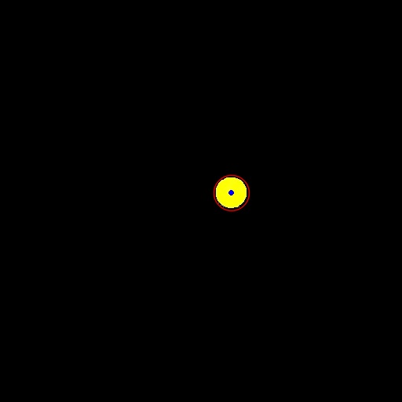
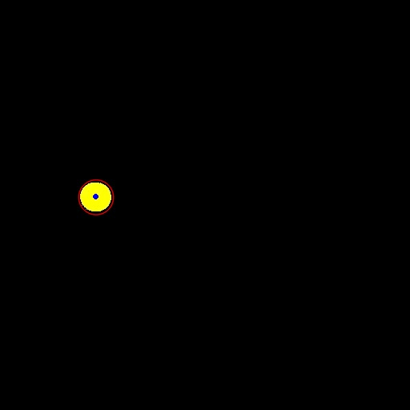
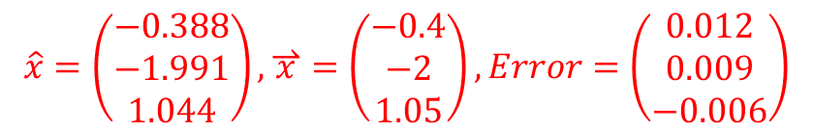
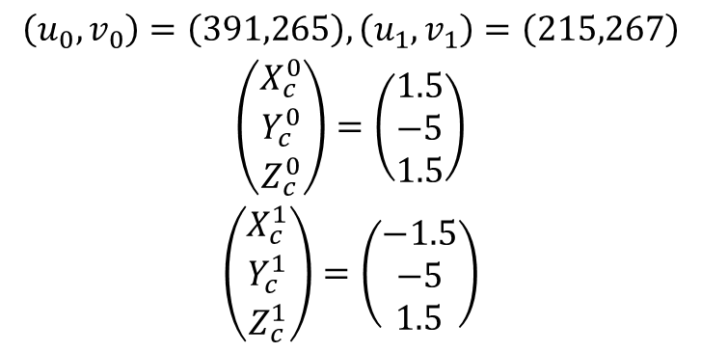
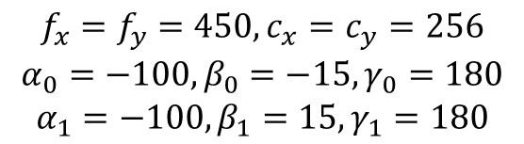
初步驗證
$$\begin{matrix}f_{x}=f_{y}=450,c_{x}=c_{y}=256 \\ α_{0}=−100,β_{0}=−15,γ_{0}=180 \\ α_{1}=−100,β_{1}=15,γ_{1}=180\end{matrix}$$
$$\begin{matrix}\left(u_{0},v_{0}\right)=\left(391,265\right),\left(u_{1},v_{1}\right)=\left(215,267\right) \\ \left(\begin{matrix}X_{c}^{0} \\ Y_{c}^{0} \\ Z_{c}^{0}\end{matrix}\right)=\left(\begin{matrix}1.5 \\ −5 \\ 1.5\end{matrix}\right) \\ \left(\begin{matrix}X_{c}^{1} \\ Y_{c}^{1} \\ Z_{c}^{1}\end{matrix}\right)=\left(\begin{matrix}−1.5 \\ −5 \\ 1.5\end{matrix}\right)\end{matrix}$$
$$\begin{matrix}\hat{x}=\left(\begin{matrix}−0.388 \\ −1.991 \\ 1.044\end{matrix}\right),\overset{⇀}{x}=\left(\begin{matrix}−0.4 \\ −2 \\ 1.05\end{matrix}\right),Error=\left(\begin{matrix}0.012 \\ 0.009 \\ −0.006\end{matrix}\right)\end{matrix}$$
(meter)

